Slide 1
Real Estate Sales Dashboard
by CHHAVi agrawal

Slide 2
Overview
The goal of this project is to develop an interactive and insightful Real Estate Sales Dashboard using Power BI. This dashboard serves as a powerful tool for stakeholders, enabling them to explore, analyze, and understand real estate sales trends across various towns and property types, leading to more informed decision-making. This project leverages advanced data visualization techniques to transform raw sales data into a comprehensive and intuitive dashboard.
This Real Estate Sales Dashboard serves as a central hub for data-driven insights, supporting stakeholders in making well-informed, strategic decisions that enhance business outcomes in the real estate market.

Slide 3
Dataset
The dataset spans from 05-04-1999 to 30-09-2022, capturing over two decades of real estate transactions across different towns. The dataset was sourced from [(https://catalog.data.gov/dataset/real-estate-sales-2001-2018)].
The dataset used in this dashboard includes several columns representing different aspects of real estate sales transactions:
1.Serial Number: A unique identifier for each transaction.
2.Town: The town where the real estate transaction took place.
3.Property Type: The type of property involved in the transaction (e.g., Condo, Single Family, Residential, etc.).
4.Residential Type: The classification of the property as residential or non-residential.
5. Sale Amount: The price at which the property was sold.
6.Assessed Value: The value assigned to the property for tax purposes.
7.Sales Ratio: The ratio of the sale amount to the assessed value, indicating whether the property was sold above or below its assessed value.
8.Record Year: The year the transaction was recorded.
9.Month: The month in which the sale occurred.
10.Sale Date: The specific date of the transaction.

Slide 4

Key Performance Indicators (KPIs)
Count of Serial Number (90.837K): This metric tracks the total number of these records within the dataset. This provides an overview of the dataset size, indicating the volume of transactions analyzed.
Sum of Assessed Value (295bn): This metric reflects the total value assigned to properties by local governments or authorities for tax-related evaluations.
Sum of Sale Amount (420bn): The sale amount is the final price at which properties were sold. This KPI highlights the overall market activity, providing a sense of the total revenue generated from property sales.
Average of Sale Amount (398.96K): The average sale amount is the mean value of all sales transactions, calculated by dividing the total sales by the number of transactions. This KPI helps stakeholders understand the typical price point for properties within the dataset, offering insights into the general market value.
Average of Sales Ratio (9.96): The sales ratio is the ratio of the sale amount to the assessed value. This metric provides an understanding of how property sale prices compare to their assessed values, indicating trends in market pricing versus tax assessments. A higher sales ratio could suggest an underestimation of property values by assessors, or a strong seller’s market.

Slide 5
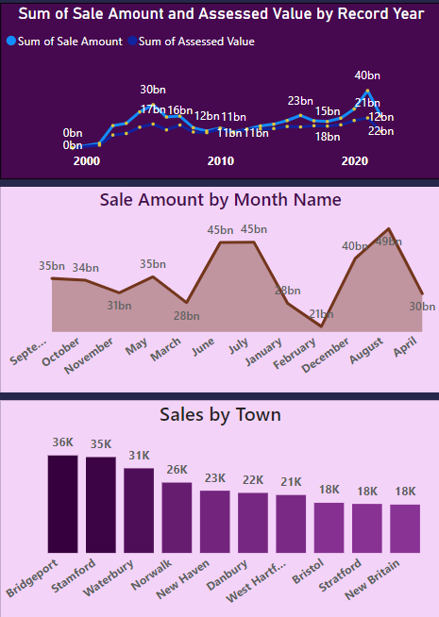
This line chart tracks the total sum of real estate sales and assessed property values over the years. Significant spikes can be observed around 2019 and 2020, where the sum of sale amounts reaches around 40 billion and assessed values at 22 billion, indicating a flourishing market in these years. These peaks might correlate with favorable economic conditions or market demand. Understanding what drove these increases can guide future decisions.
This area chart showcases the distribution of total sales by month, helping to identify seasonal patterns. July and August are the strongest months, with sales peaking at 45 billion in July and 49 billion in August. This suggests a strong seasonality effect, with summer being the most active period for real estate transactions. The beginning of the year (January, February) and the end of the year (December) see relatively lower sales, around 21 billion in February, which could point to seasonal slowdowns. Stakeholders can capitalize on these seasonal trends by timing marketing and promotional efforts to align with high-sales months.
This bar chart ranks towns by the total sales amount, identifying top-performing locations.Bridgeport (36K) and Stamford (35K) lead in total sales, making them key focal points for real estate investments. These insights enable stakeholders to concentrate on high-performing towns for future investments and to explore opportunities for growth in towns with lower sales.

Slide 6
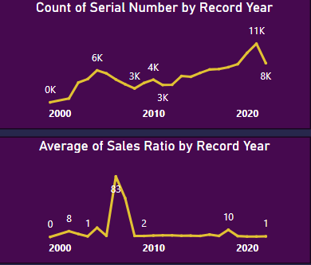
This graph likely represents the number of real estate transactions or properties sold each year, with each serial number corresponding to a unique transaction. These spikes could indicate periods of high market activity, possibly due to favorable economic conditions, lower interest rates, or housing demand. The slight drop from 2020 to 2021, where transactions decrease to 8K, might suggest market cooling or a shift in market dynamics, possibly due to economic factors or changing buyer behavior.
This graph represents the average sales ratio for properties each year, which could be interpreted as a measure of property value, market profitability, or pricing trends. There is a pronounced spike around 2008, where the average sales ratio jumps to 83. This could be due to a bubble in property prices before the financial crisis or an exceptionally high sales price relative to previous years. The stability in the sales ratio in the last decade suggests a more consistent and possibly healthier market environment, with fewer extreme price fluctuations.

Slide 7
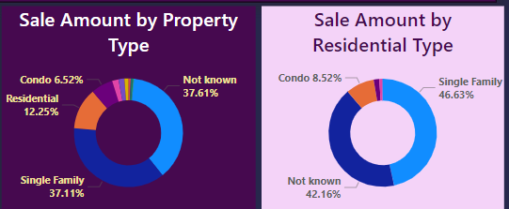
These visualizations allow stakeholders to see which property types and residential categories are contributing the most to sales, aiding in market trend analysis and investment decisions. Single Family Homes: These are consistently a major segment in both charts, reflecting their strong presence and value in the real estate market. Data Gaps: The large "Not Known" segments in both charts highlight potential data quality issues or missing information. Addressing this gap could provide clearer insights into property trends. Condos: While making up a smaller portion of the market, condos are still an important category, especially in urban settings where they might be in higher demand. .

Slide 8
Recommendations to Stakeholders
Focus on High-Performing Towns:
Prioritize investment in towns that consistently show high sales performance. Leverage these areas for continued growth and expansion.
Capitalize on Single-Family Home Demand:
Single-family homes represent a significant portion of sales. Continue to cater to this demand by focusing development efforts on high-quality, single-family properties in thriving markets.
Target Underperforming Regions:
Identify and explore underperforming towns with untapped potential. Implement marketing campaigns and promotional strategies to boost sales and attract new buyers in these regions.
Refine Pricing Strategies:
Utilize the sales ratio analysis to refine pricing strategies. Ensure that properties are competitively priced to match or slightly exceed assessed values, while remaining attractive to potential buyers.
Improve Data Quality:
Address the "Not Known" categories in the dataset. Invest in data collection and validation processes to enhance decision-making accuracy and fill gaps in the analysis.

Slide 9
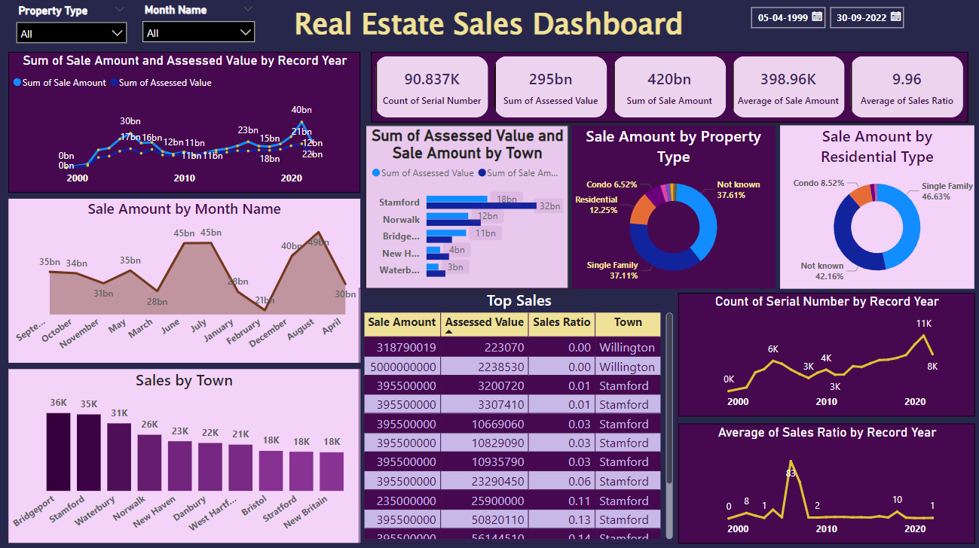
Dashboard

Slide 10
Conclusion
The dashboard provides a holistic view of real estate sales trends across various towns and property types, helping stakeholders make data-driven decisions.
Identified top-performing towns and high-value property types, as well as underperforming areas with potential for future investments.
Analysis of sales ratios offers valuable insights into pricing strategies, helping stakeholders understand market dynamics and optimize pricing for better returns.
Visualizations highlight key market patterns, enabling stakeholders to focus on growth opportunities, adjust strategies, and maximize profitability.
Leverage identified trends and insights to shape future investment decisions.
Address data gaps (e.g., "Not Known" categories) to enhance the accuracy and effectiveness of the analysis.

